Slide 1

Data-Driven Consumer Insights Platform
Uncovering patterns in spending, preferences, and engagement across 3,900 transactions to improve marketing strategies and customer experience.

Slide 2

Project Overview
Business Objective
Leverage consumer shopping data to identify trends, improve customer engagement, and optimize marketing strategies.
Dataset Scope
3,900 rows × 18 columns — covering customer demographics, purchase details, discounts, reviews, and purchase frequency.

Slide 3

Data Preparation
Clean
Transform
Engineer
Validate
Systematic cleaning and feature engineering ensured a reliable, analysis-ready dataset with consistent structure and no redundant fields.

Slide 4

Revenue by Gender & Discounts
Male Customers
Discount Users
Generate higher total revenue compared to female customers.
Customers using discounts often spend above average.
Top Rated Products
Gloves, Sandals, and Boots lead in customer review ratings.

Slide 5


Shipping & Spending Behavior
Express Shipping = Higher Spend
Customers who choose express shipping consistently spend more per transaction than those using standard or free shipping options.
Enhancing the express shipping experience could be a key lever for increasing average order value.

Slide 6


Subscriber vs. Non-Subscriber Insights
29.23%
70.77%
Subscribers
Non-Subscribers
Similar spending per order, but lower total revenue contribution.
Majority of customers — represent the largest revenue share.
Retention is Strong
Most customers are classified as loyal, indicating strong retention across the base. Subscription conversion remains a key growth opportunity.

Slide 7



Revenue by Age Group
Young Adults Lead
Young adults contribute the highest revenue of any age segment, making them the most valuable demographic for targeted marketing campaigns.
Prioritize young adult-focused campaigns to maximize revenue impact.

Slide 8
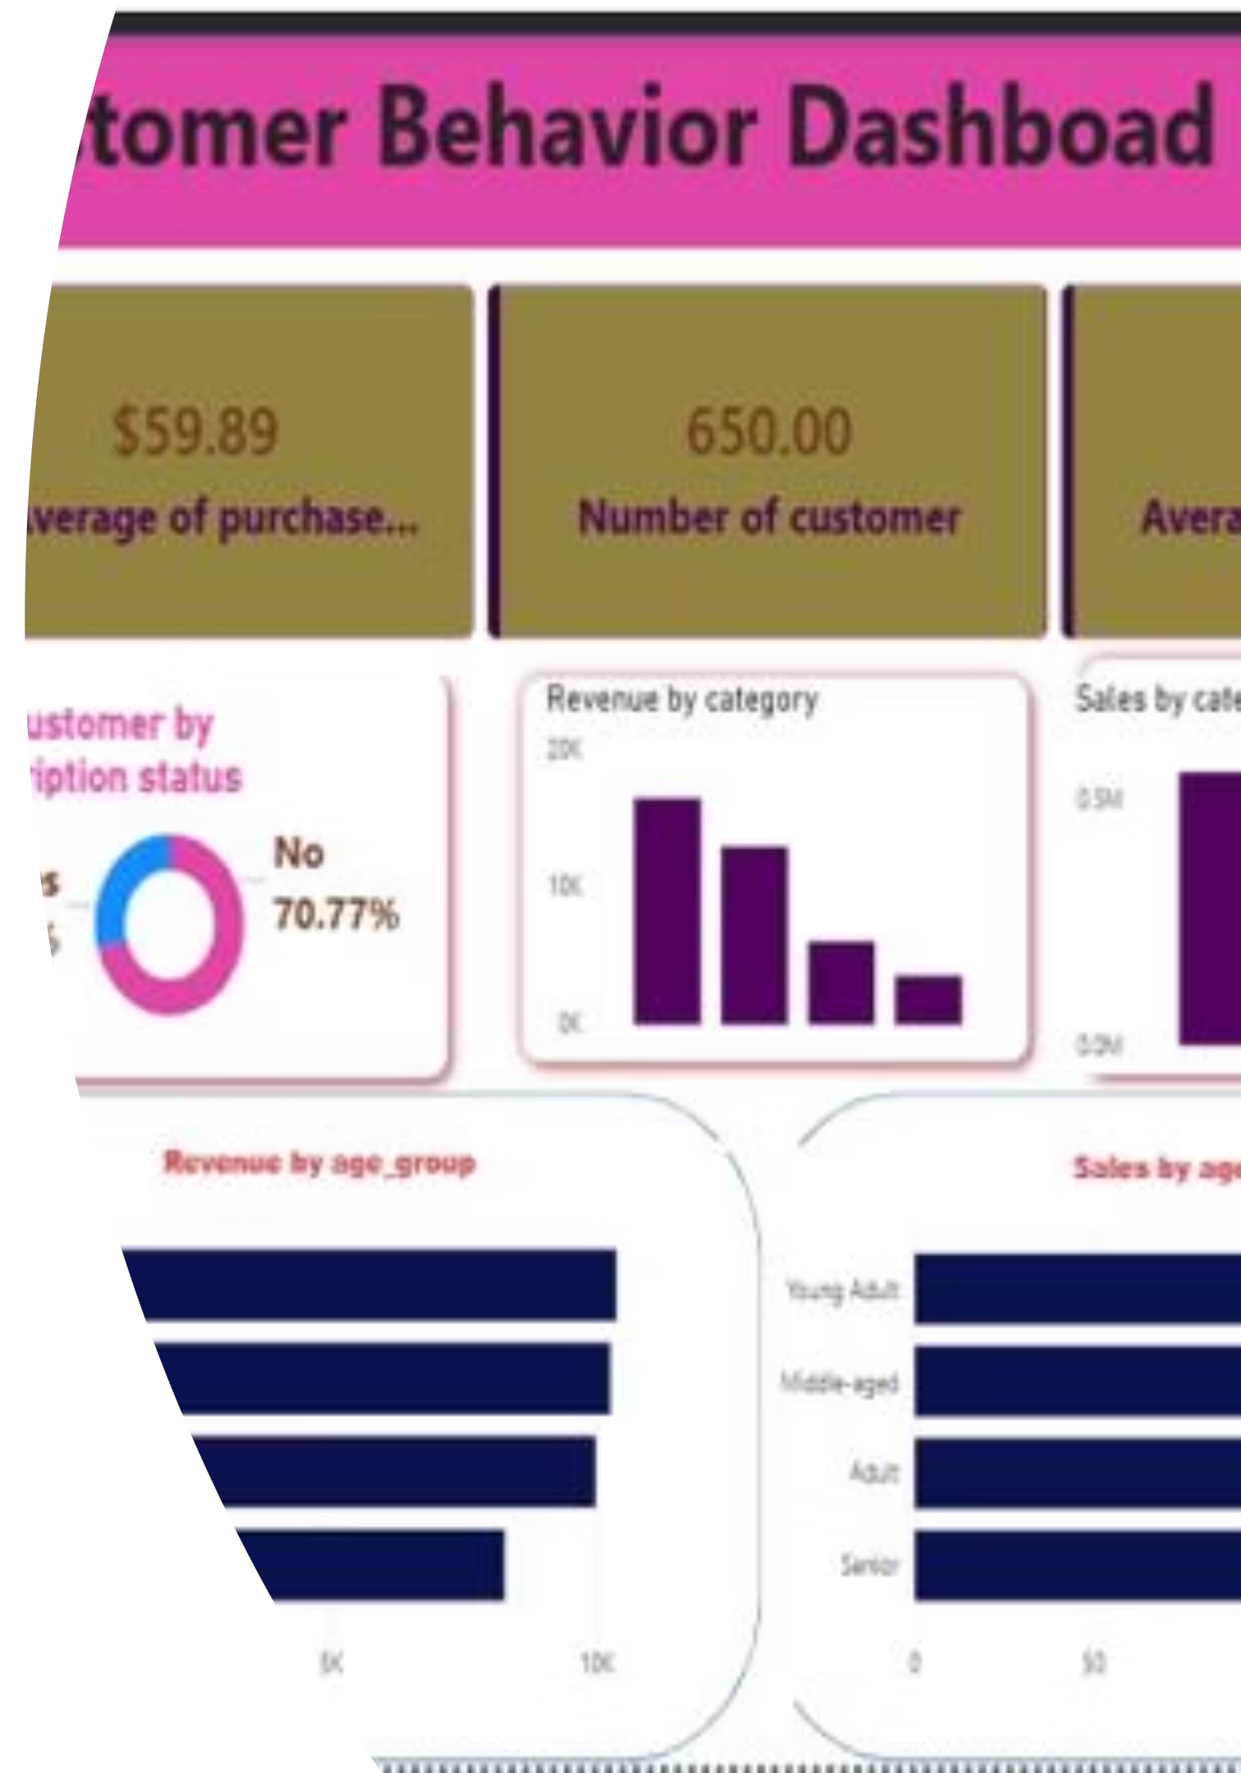
Power BI Dashboard
$59.89
650
Avg. Purchase
Customers
3.71
Avg. Rating

Slide 9
Dashboard Features
Interactive Filters
Revenue Visuals
Subscription Split
Slice data by gender, category, subscription status, and shipping type.
Bar charts for revenue and sales by category and age group.
Donut chart showing 29.23% subscribers vs. 70.77% non-subscribers.

Slide 10

Recommendations
Target Young Adults & Loyal Customers
Focus marketing efforts on the highest-revenue segment.
Optimize Discount Strategies
Refine offers around top-rated, high-performing products.
Boost Subscription Conversion
Convert the 70.77% non-subscriber base with targeted incentives.
Enhance Express Shipping
Invest in the express experience to drive higher average order values.

